Slide 1
Quantum Computation
A Simple Mathematical Introduction Based on Linear Algebra
Prof. Carlos R. Paiva
DEEC – IST, Lisbon University
April 2020

Slide 2
Convex Sets

Slide 4
Algebraic Structures
A Very Short Introduction

Slide 7
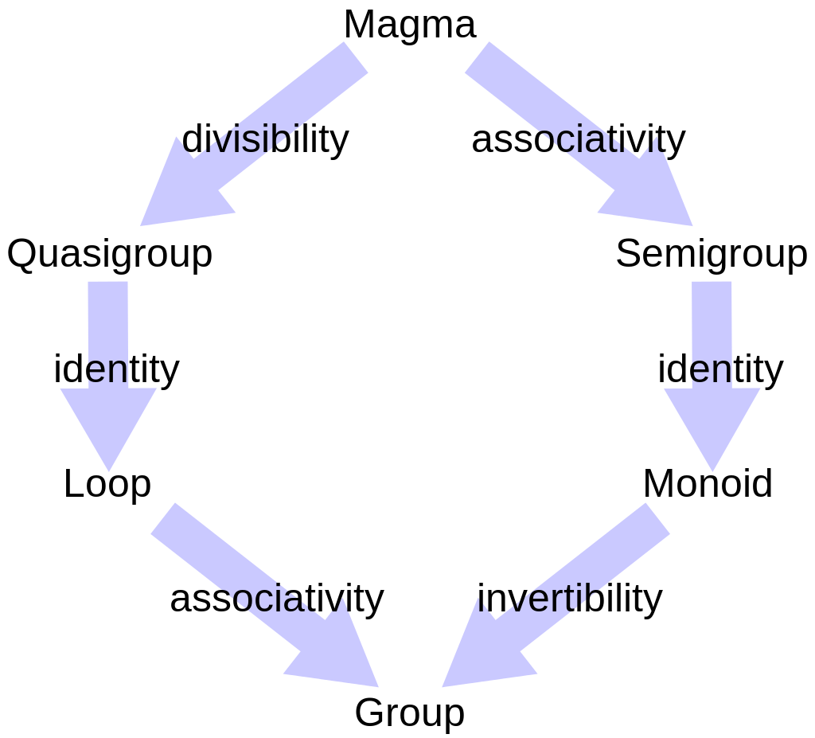

Slide 9
The definition of real numbers is a subtle question.
A possible construction of the real numbers is the concept of Dedekind cut.

Slide 10
The most common numbers

Slide 16
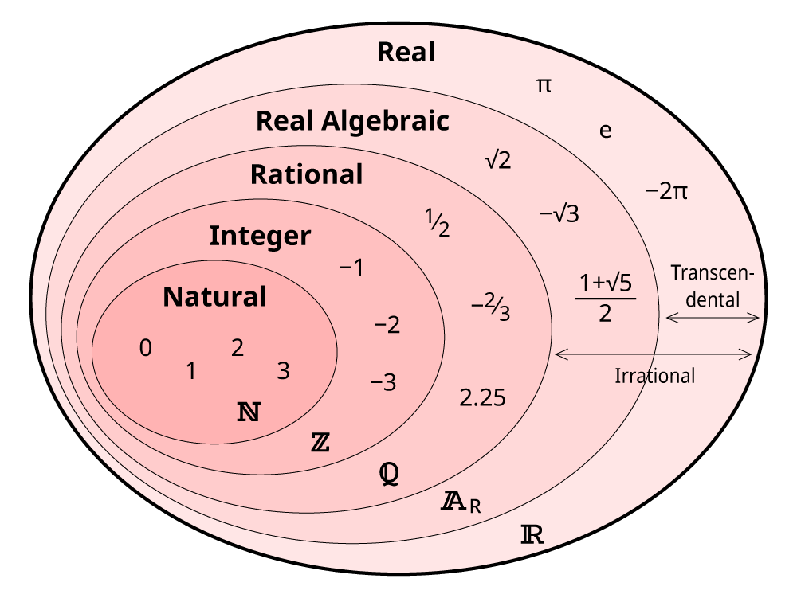

Slide 17
Quaternions

Slide 27
Algebra Over a Field

Slide 28
An algebra over a field (or just an algebra) is a vector (or linear) space equipped with a bilinear product.

Slide 30
Octonions
The octonions form a normed division algebra of dimension eight over the reals.
We cannot characterize the octonions as a ring as its multiplication is not associative.
The nonzero octonions do not form a group under multiplication. However, they form a loop (a Moufang loop).
Applying the Cayley-Dickson construction to the octonions produces the sedenions. The sedenions are not a division algebra because they have zero divisors.

Slide 31
Quantum Bits
(Qubits)

Slide 37
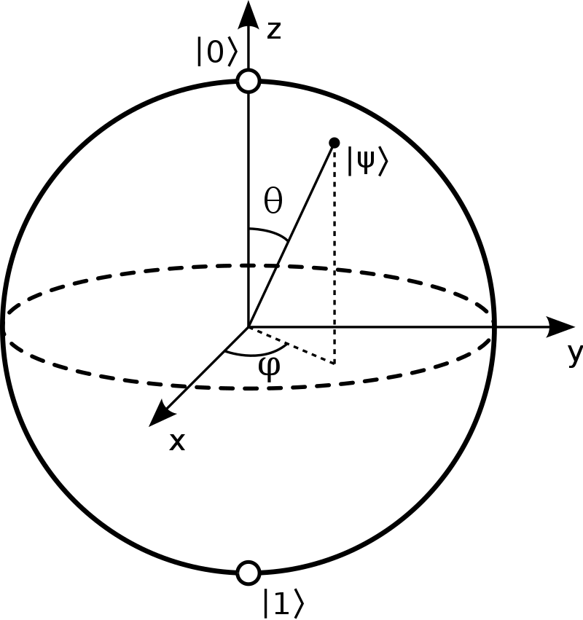
Bloch sphere

Slide 38
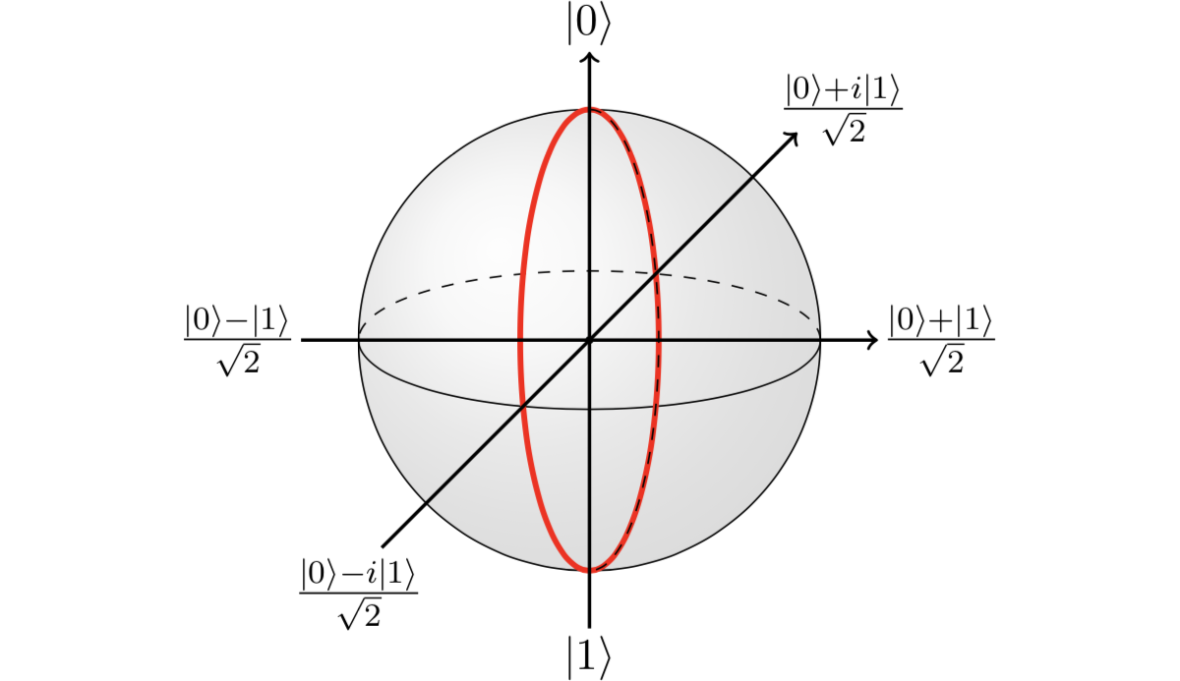

Slide 41
Homeomorphism
=
Topological Isomorphism

Slide 50
Stereographic Projection

Slide 51
Hilbert Spaces

Slide 52
A complete inner product space, commonly denoted by H, is called a Hilbert space.
A trivial example of a Hilbert space, which is the one case we are always considering here, is a finite-dimensional complex vector space.

Slide 55
Linear Operators
and
Matrices

Slide 56
The example on the next slides intends to show that the same linear operator is represented by different matrices in different bases.
Only in the standard (or natural) basis of orthonormal vectors is the matrix representation of a given linear operator (almost) obvious.

Slide 62
Hermitian and Unitary Operators

Slide 80
Projectors
(or Projection Operators)

Slide 84
First Example

Slide 88
Second Example

Slide 92
Third Example

Slide 97
Pauli Operators

Slide 105
Pure states

Slide 116
Hadamard Operator

Slide 123
Single Qubit Rotations

Slide 133
First Example

Slide 135
Second Example

Slide 137
Third Example

Slide 140
Spectral Decomposition

Slide 145
Example

Slide 149
Tensor Product
and
Entanglement

Slide 150
«I would not call [entanglement] one but rather the characteristic trait of quantum mechanics, the one that enforces its entire departure from classical lines of thought.»
Erwin Schrödinger,
“Discussion of probability relations between separated systems,”
Mathematical Proceedings of the Cambridge Philosophical Society,
Vol. 31, Issue 4, pp. 555 – 563, 1935.

Slide 151
We are going to introduce tensors in the rather limited context that interests us.
That is: We are always considering finite-dimensional vector spaces ^{n} defined over the field  of complex numbers.

Slide 170
First Example

Slide 173
Second Example

Slide 178
Third Example

Slide 185
Fourth Example

Slide 188
Density Operator

Slide 195
First Example

Slide 199
Second Example

Slide 201
Bloch Sphere
and
Mixed States

